Slide 2
FOR A COMMON SPIRIT OF EUROPE
“Inspired by our Christian faith and the need to strengthen Christian confidence, witness and service, the European Christian Convention (ECC) seeks to make a significant contribution, towards greater unity and integration of people in Europe and to mobilize responsibility”
(Preamble of the association European Christian Convention, 2016)

Slide 3
CHARTA OECUMENICA - 2001
"We are convinced that the spiritual heritage of Christianity constitutes an empowering source of inspiration and enrichment for Europe. On the basis of our Christian faith, we work towards a humane, socially conscious Europe, in which human rights and the basic values of peace, justice, freedom, tolerance, participation and solidarity prevail"

Slide 4
Who we are
We are a European, non-profit association with 32 members from all over Europe.
Our MEMBERS are: (selection)
Akademie Solidarische Ökonomie – Stiftung Ökumene; Germany
Center Ecumena; Belarus
Center for Church Development (ZKE), University of Zurich; Switzerland
Central Committee of German Catholics (ZDK) – Zentralkomitee der deutschen Katholiken e.V.; Germany
Church and Peace – the European ecumenical network of peace church communities, congregations, organisations and institutions; Europe
Colloquium of European Parishes (CEP); Spain
Deutscher Evangelischer Kirchentag (DEKT); Germany
European Laity Forum; Europe
Evang.-ref. Kirche des Kantons St. Gallen; Switzerland
Evangelisch-Lutherische Kirchengemeinde Ottensen (Ev.Kirche Hamburg-Ottensen-Altona); Germany
Federation of Swiss Protestant Churches (SEK – FEPS); Switzerland
Fellowship of European Broadcasters; Europe
Finland Kirchentag (Kirkkopalvelut ry); Finland
Latvian Christian Academy; Latvia
Lutheran Church in Hungary and “Szelrozsa” Youth Jamboree – Project; Hungary
Missionsakademie an der Universität Hamburg; Germany
Moravian Church – European Continent Province (Evangelische Brüder-Unität-Herrnhuter Bürgergemeinde); Europe, Netherlands
Oikosnet Europe; Europe
Orthodox Academy of Crete; Greece
Reformed Church of Zurich; Switzerland
St.Andrew’s Biblical Theological Institute (Moscow); Russia
Stiftung Ökumene – Foundation Oikoumene; Germany
The Evangelical Church of the Augsburg Confession in Poland; Poland
The Sigtuna Foundation (Sigtunastiftelsen); Sweden
World Student Christian Federation Europe (WSCF-E); Europe

Slide 5
Current BOARD
The association is governed by a board of currently 14 members.
The board is lead by a chair and three vice chairs. These are:
Sven Giegold – Member of the European Parliament – Germany / Belgium – Chair of the ECC Board
Peter Annegarn – European Laity Forum – Belgium – Vice Chair of the ECC Board
Jeannette Behringer – Reformed Church of the Canton of Zurich – Switzerland – Vice Chair of the ECC Board
Katerina Karkala-Zorba – Orthodox Academy of Crete – Greece – Vice Chair of the ECC Board
Members of the Board
Christina Aus der Au – Centre for Church Development at the University of Zurich – Switzerland
Alexei Bodrov – St Andrew's Biblical Theological Institute Moscow – Russia
Annika Foltin – World Student Christian Federation, Europe – Germany
Jari Kupianien – Kirkkopalvelut Rp, Kirkkopäivät (Kirchentag Finland) – Finland
Balázs Mesterházy – Szélrὁzsa Hungarian Youth Meeting, Evangelical Lutheran Church in Hungary – Hungary
Holger Müller – Ev. Landeskirche in Baden / Ev. Kirchgemeinde Staffort-Büchenau – Germany
Leslie Nathaniel – Diocese in Europe, Church of England, Conference of European Churches – England / Germany
Krsto Stanisic – Serbian Orthodox Church – Montenegro
(Rebekka Højmark Svenningsen – Ev. Luth. Church in Denmark – Denmark)
(Jérôme Vignon – Semaines Sociales de France – France)

Slide 6
What is our Goal?
The goal of the ECC is to organize a large-scale ecumenical gathering of Christians in Europe and beyond.
The event shall …
… be an event open to everyone who is interested and willing to enter into dialog with the other participants
… be carried by worship and prayer
… be participatory
… have open spaces for discussions, bible studies and work shops
… have between 10’000 -15’000 participants from all over Europe
... take place in 2023/2024
… possible venues: Vienna, Strassburg, Zürch, ….

Slide 7
Our Common Vision
Coming from a diversity of national, cultural and social backgrounds, Europe is our common home. Living our faith in different church traditions, we are united by the same gospel. Our diversity enriches us and we want to celebrate our faith together.
We acknowledge our responsibility to create a future with hope for the whole of Europe and for the world.
We stand up for peace, freedom and well-being, compassion and solidarity.
Inspired by our Christian faith, we want to strengthen the fabric of European society.
We want to live up to the Ecumenical commitment of the churches in Europe for unity.
Everyone is invited to join us on this journey!

Slide 8
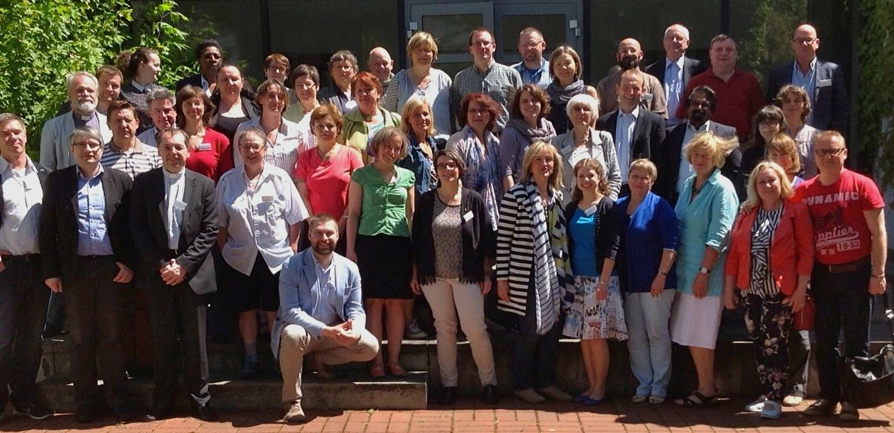
What happened so far? – our HISTORY
Bad Boll 2015
The First meeting
60 participants from
20 European countries
Theme/Question of the meeting :
«Is there a wider interest in an European Christian Meeting?”

Slide 9
a Roadmap was drafted
Christianity
Diversity of traditions – Unity by the same gospel
Responsibility for a future with hope for Europe/the world
Europe
Christion Vision for peace, freedom and justice
For a humane, socially conscious Europe in which human rights and the basic values of peace, justice, freedom, tolerance, participation and solidarity prevail (Charta Ecumenica)
Character
Celebration of faith
Christian civil society

Slide 10
Results from Bad Boll
an interim name was developed: “European Christian Convention”,
an interim Coordination Team received a mandate to drive the project forward

Slide 11
MISSION
WE SHALL BE CHRISTIAN WOMEN AND MEN OF OUR CHURCHES IN SOCIETY
AND CHRISTIAN WOMEN AND MEN OF SOCIETY IN OUR CHURCHES

Slide 12
KAPPEL 2016

Slide 13
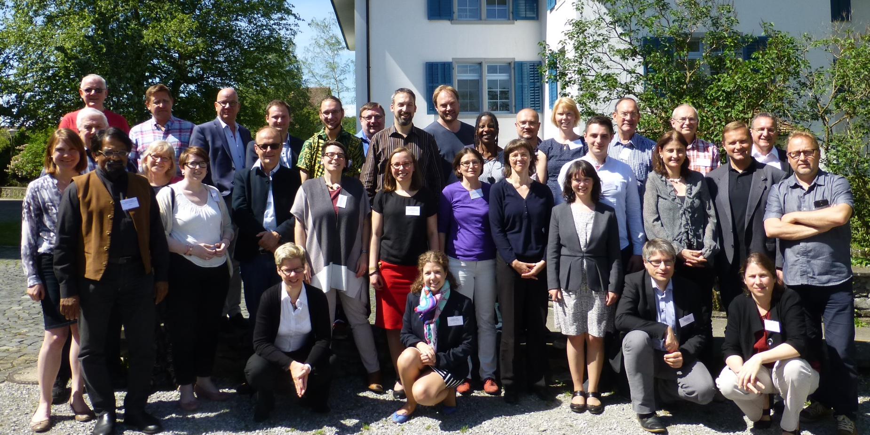
Kappel 2016
Second Meeting
33 participants from 14 European countries to evaluate the process of the ECC.
Theme/Question:
«How has the ECC developed during the last year? Do we want to proceed?”

Slide 14
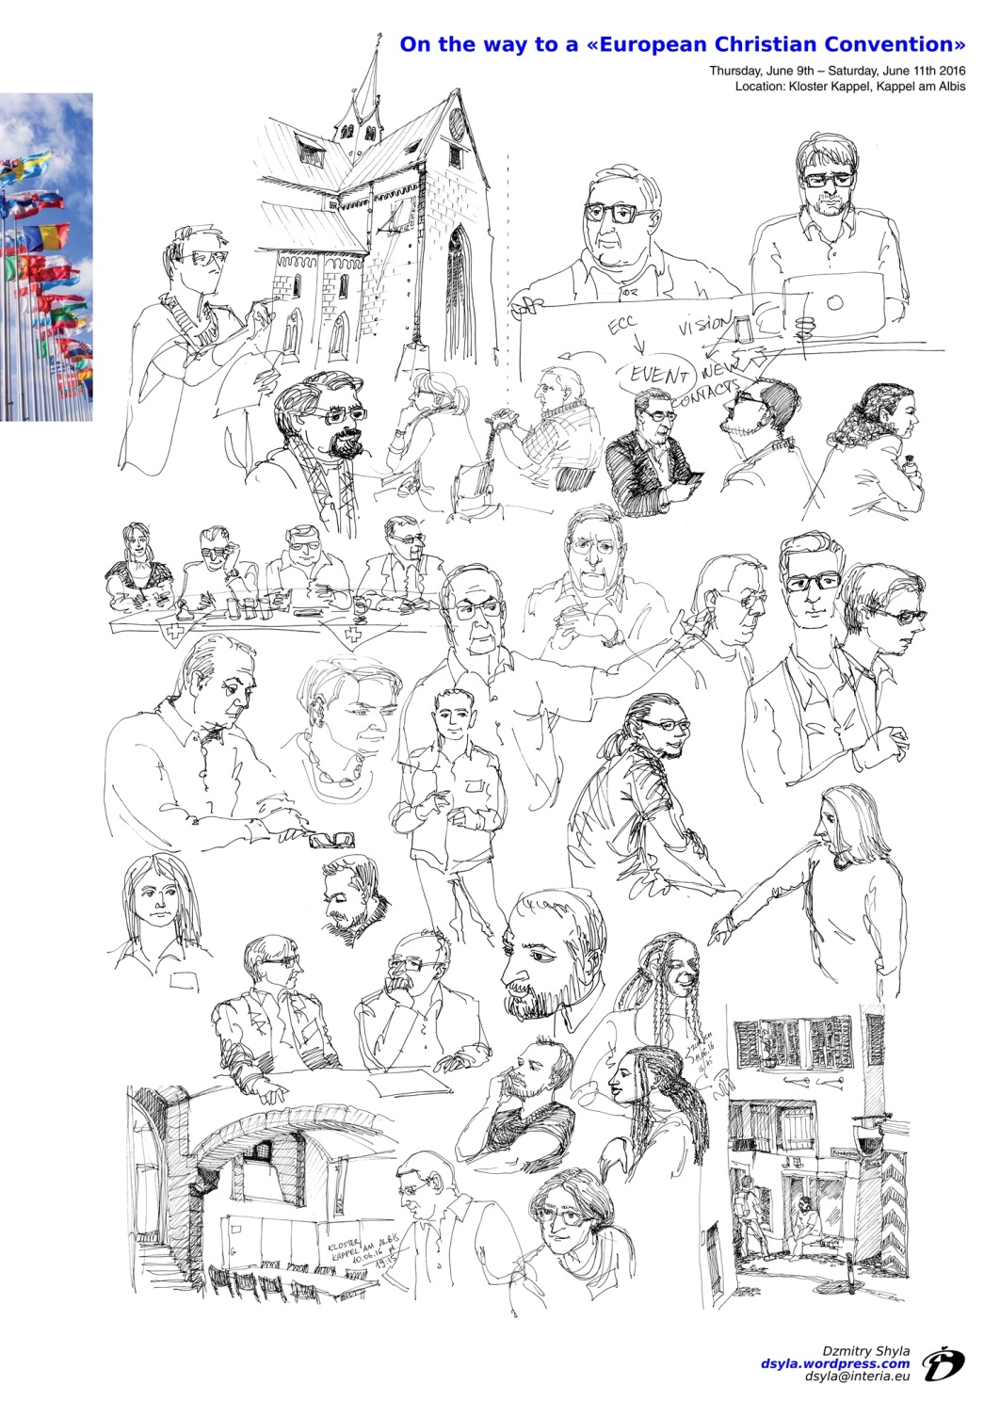
Results from Kappel
The association European Christian Convention is founded.
The constitution is adopted.
An interim board is nominated to serve until the first Members’ Assembly.

Slide 15
January 2017 The association EUROPEAN CHRISTIAN CONVENTION (ECC) is officially and legally registered as an “Association Internationale Sans But Lucratif” in Belgium.

Slide 16
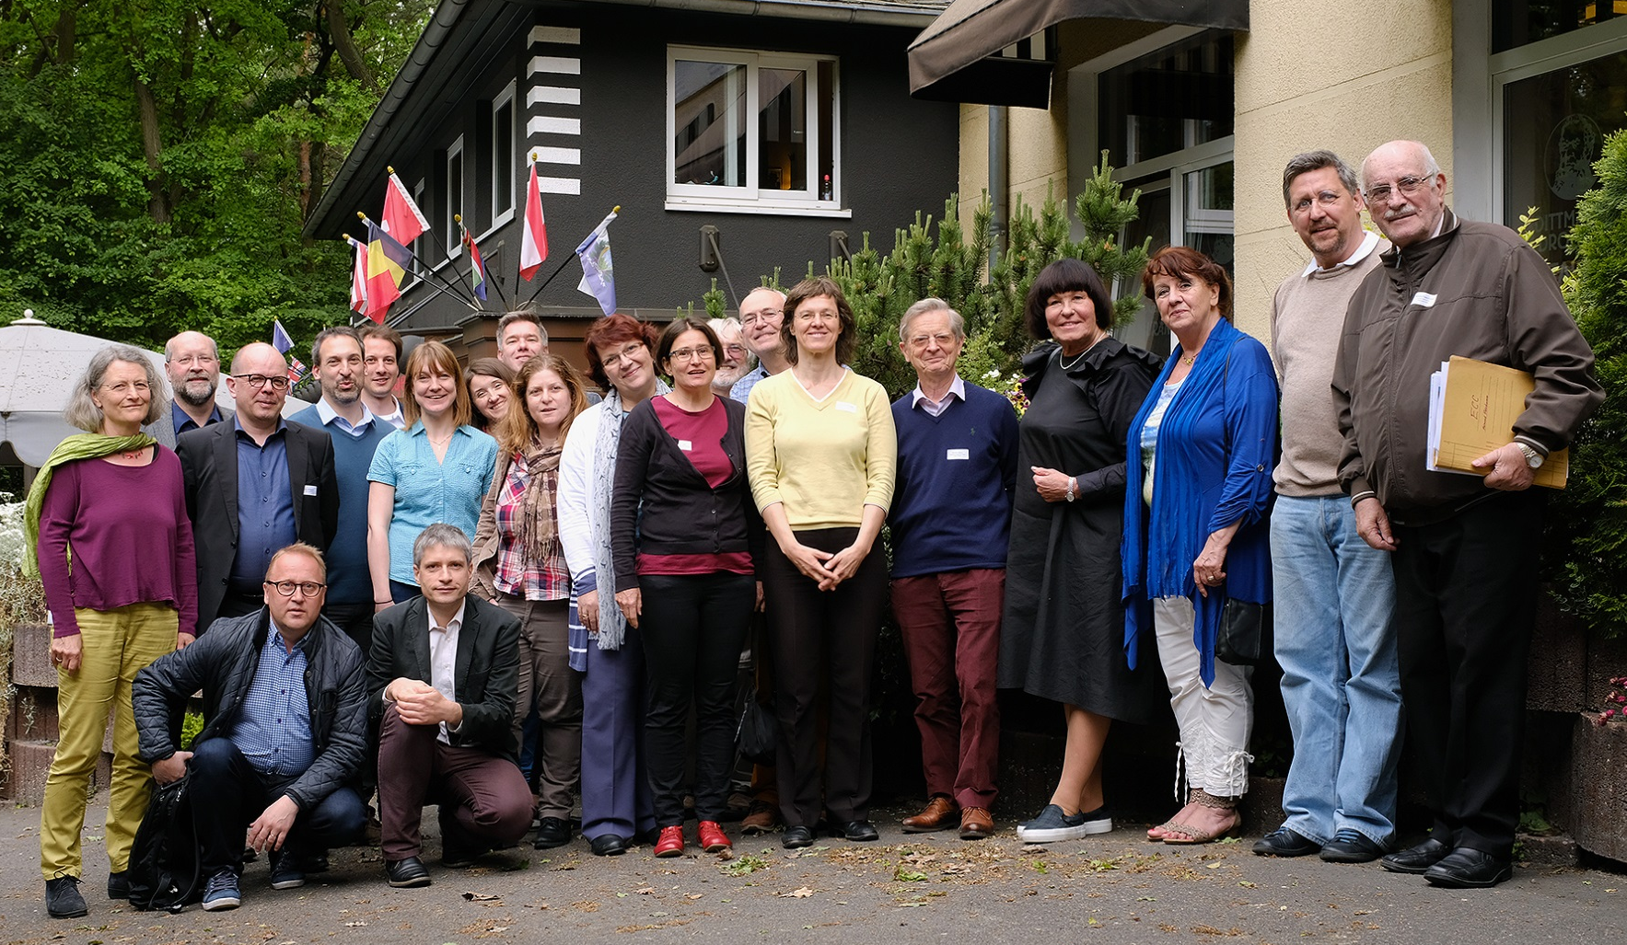
First Members’ Assembly Grünau 2017
Delegates from the 25 members of the association European Christian Convention met in Grünau for their first members’ assembly

Slide 17
Results from the First Members’ Assembly
Election of the current ECC board.
A membership fee policy is set and adopted.
A provisional timeline is adopted
End of 2017: An open call of application is send out.
Until the end of 2018: Churches, Christian organizations and their networks may apply to host the first ECC.
Oct 2019: The members’ assembly will decide on the location based on the applications.

Slide 18
Presence and participation of ECC
May 2016 : Katholikentag - Münster (« Europatag », common booth with ELF on the ZdK booth)
May 2017: Ev. Kirchentag - Berlin (ECC event: « Europa eine Seele geben » and ECC booth )
March 2018: joint meeting CCEE-KEK - Brussels (ECC presentation)
December 2018: Caritas Europa – Brussels (ECC presentation)
April 2019: meeting with Kard Koch (PC Unity of Christians) and Mgr Brian Farrell – Vatican Rome

Slide 19
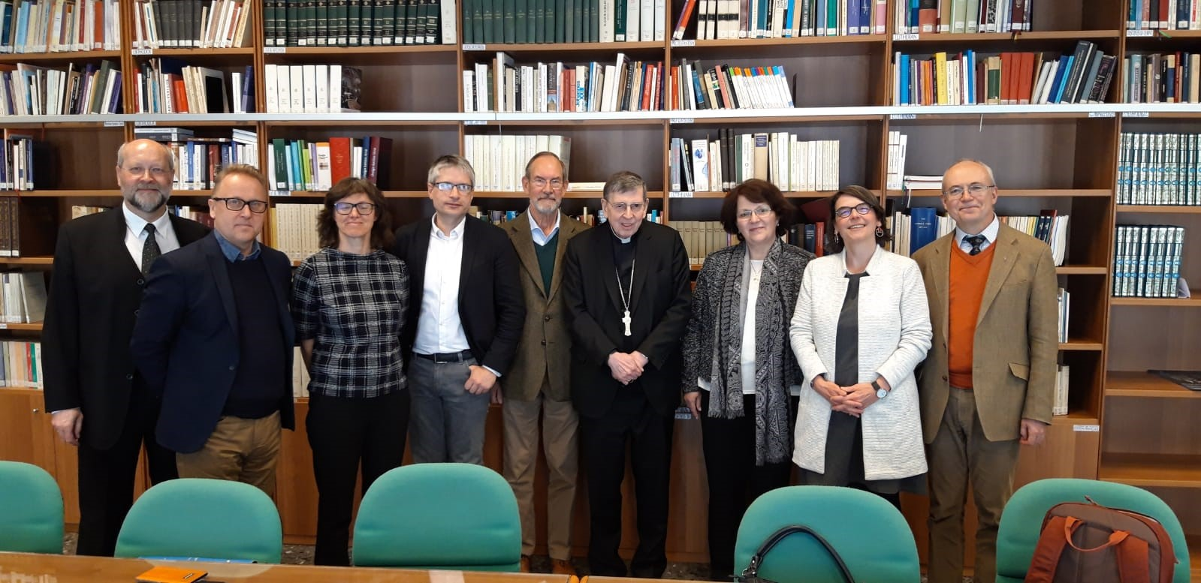
Presence and participation of ECC

Slide 20
NEXT STEPS
June 2019: Kirchentag – Dortmund – ECC event “ Europa – Verantwortung und Herausforderung für die Kirchen”
July 2019: appointment with Mgr Hollerich COMECE - Luxembourg
August 2019: Appointment with Mgr Bagnasco CCEE - Genova
October 2019: 2nd GA ECC – Orthodox Academy Crete
May 2021 : 3. Ökumenischer Kirchentag - Frankfurt

Slide 21
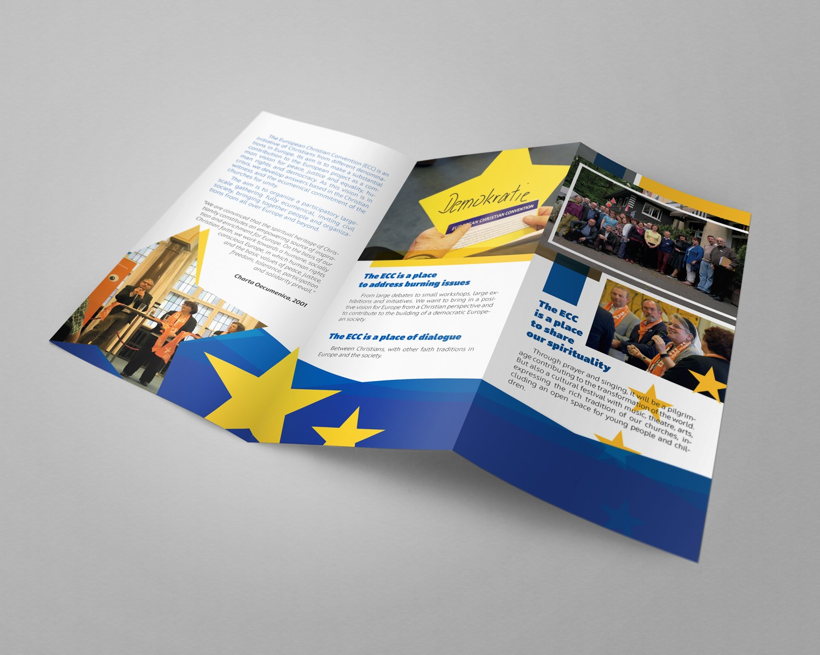
NEW

Slide 22
WE INVITE YOU TO JOIN US on the journey to the EUROPEAN CHRISTIAN CONVENTION

Slide 23
Contact – Where to find us?
www.european-christian-convention.eu
mail@europan-christian-convention.eu

